Slide 1
Forward / Backward Algorithms

Slide 2
Learning Objectives
To learn about how to calculate the probability of an input sequence given an HMM
To learn about how to calculate the marginal probability of a specific state at a particular position in the observed sequence

Slide 3
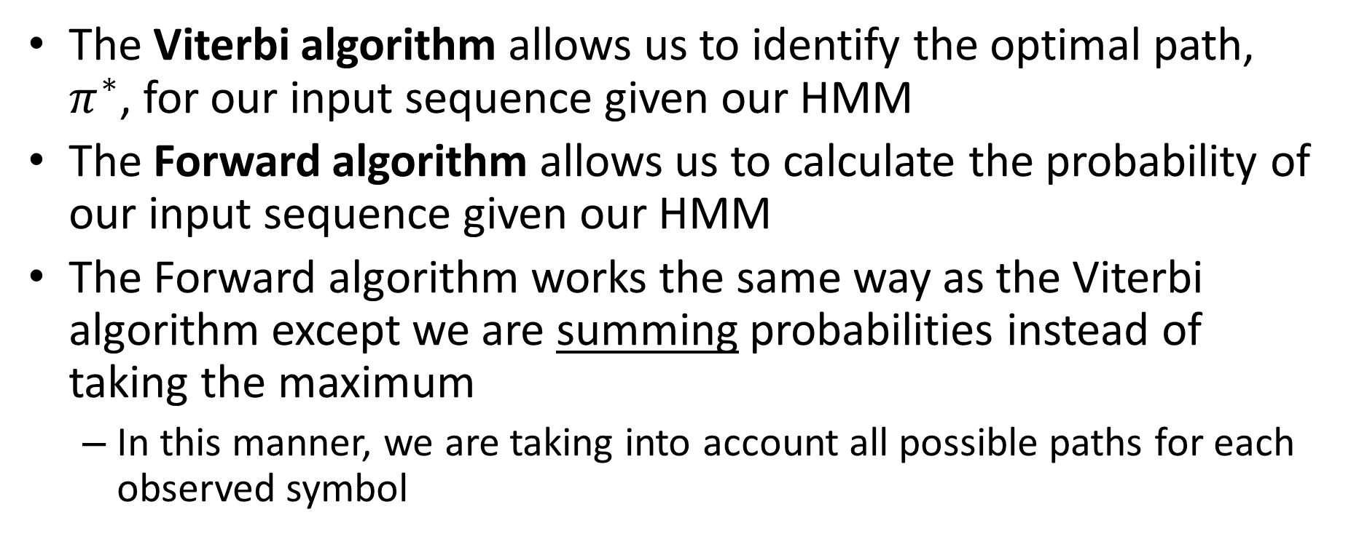
Forward Algorithm
The Viterbi algorithm allows us to identify the optimal path, $π^{∗}$, for our input sequence given our HMM
The Forward algorithm allows us to calculate the probability of our input sequence given our HMM
The Forward algorithm works the same way as the Viterbi algorithm except we are summing probabilities instead of taking the maximum
In this manner, we are taking into account all possible paths for each observed symbol

Slide 4
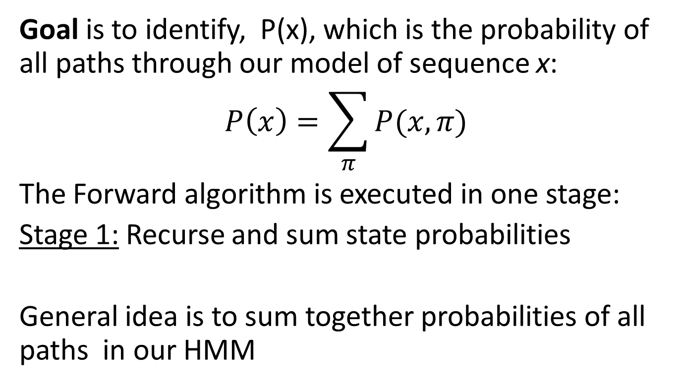
Forward Algorithm
Goal is to identify, P(x), which is the probability of all paths through our model of sequence x:
$$P\left(x\right)=\sum_{π}{P(x,π)}$$
The Forward algorithm is executed in one stage:
Stage 1: Recurse and sum state probabilities
General idea is to sum together probabilities of all paths in our HMM
Durbin et al (1998) Biological Sequence Analysis, Cambridge University Press

Slide 5
Forward Algorithm Demonstration
CpG Island
P(A) = 0.1
P(C) = 0.4
P(G) = 0.4
P(T) = 0.1
0.6
0.1
β
0.4
0.1
P(A) = 0.4
P(C) = 0.1
P(G) = 0.1
P(T) = 0.4
0.9
0.9
Stage 1: Recurse and sum state probabilities
Genome
States | A | C | G | C | G | A | T | C
CpG Island | 0.1 x 0.1 = 0.01 | SUM OF 0.01 x 0.6 x 0.4 = 0.0024 AND 0.36 x 0.1 x 0.4 = 0.0144 IS = 0.0168 | SUM OF 0.0168 x 0.6 x 0.4 = 0.004032 AND 0.0328 x 0.1 x 0.4 = 0.001312 IS = 0.005344 | SUM OF 5.344E-03 x 0.6 x 0.4 = 1.283E-03 AND 3.624E-03 x 0.1 x 0.4 = 1.450E-04 IS = 1.428E-03 | SUM OF 1.428E-03 x 0.6 x 0.4 = 3.426E-04 AND 5.399E-04 x 0.1 x 0.4 = 2.160E-05 IS = 3.642E-04 | SUM OF 3.642E-04 x 0.6 x 0.1 = 2.185E-05 AND 1.057E-04 x 0.1 x 0.1 = 1.057E-06 IS = 2.291E-05 | SUM OF 2.291E-05 x 0.6 x 0.1 = 1.375E-06 AND 9.632E-05 x 0.1 x 0.1 = 9.632E-07 IS = 2.338E-06 | SUM OF 2.338E-06 x 0.6 x 0.4 = 5.611E-07 AND 3.834E-05 x 0.1 x 0.4 = 1.534E-06 IS = 2.095E-06
Genome | 0.9 x 0.4 = 0.36 | SUM OF 0.01 x 0.4 x 0.1 = 0.004 AND 0.36 x 0.9 x 0.1 = 0.0324 IS = 0.0328 | SUM OF 0.0168 x 0.4 x 0.1 = 0.000672 AND 0.0328 x 0.9 x 0.1 = 0.002952 IS = 0.003624 | SUM OF 5.344E-03 x 0.4 x 0.1 = 2.138E-04 AND 3.624E-03 x 0.9 x 0.1 = 3.262E-04 IS = 5.399E-04 | SUM OF 1.428E-03 x 0.4 x 0.1 = 5.710E-05 AND 5.399E-04 x 0.9 x 0.1 = 4.859E-05 IS = 1.057E-04 | SUM OF 3.642E-04 x 0.4 x 0.4 = 5.827E-05 AND 1.057E-04 x 0.9 x 0.4 = 3.805E-05 IS = 9.632E-05 | SUM OF 2.291E-05 x 0.4 x 0.4 = 3.665E-06 AND 9.632E-05 x 0.9 x 0.4 = 3.468E-05 IS = 3.834E-05 | SUM OF 2.338E-06 x 0.4 x 0.1 = 9.351E-08 AND 3.834E-05 x 0.9 x 0.1 = 3.451E-06 IS = 3.544E-06
P(x) = 2.095E-06 + 3.544E-06
= 5.63895E-06

Slide 6
Backward Algorithm
The Backward algorithm is -exactly- the same as the Forward algorithm, except you begin at the end of the sequence (including the end state) and work your way to the front.
So why would you need two different algorithms to calculate the same value?
Durbin et al (1998) Biological Sequence Analysis, Cambridge University Press

Slide 7
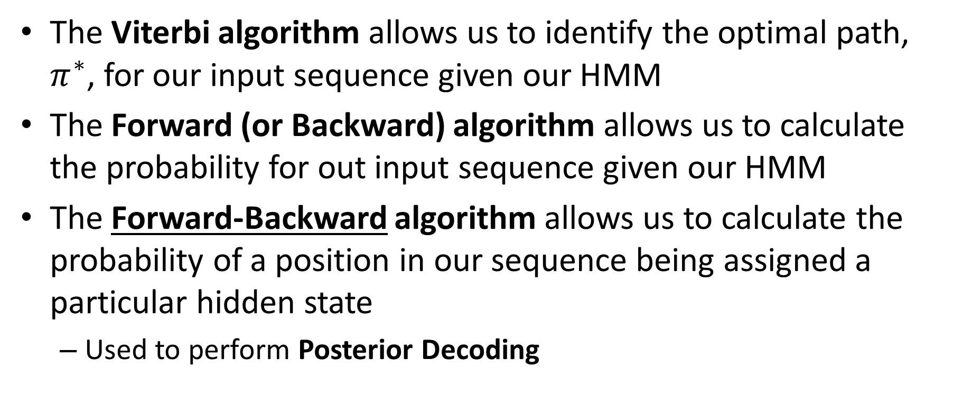
Forward-Backward Algorithm
The Viterbi algorithm allows us to identify the optimal path, $π^{∗}$, for our input sequence given our HMM
The Forward (or Backward) algorithm allows us to calculate the probability for out input sequence given our HMM
The Forward-Backward algorithm allows us to calculate the probability of a position in our sequence being assigned a particular hidden state
Used to perform Posterior Decoding

Slide 8
Forward-Backward Algorithm
In order to calculate the probability that a position be assigned a particular state we need to understand the probability of state transitions from both directions
As a result we need to calculate probability from the reverse direction of the sequence. As we have previously noted, this is called the Backward algorithm.
Similar to the Forward algorithm, except is calculated from the end of the sequence: b_{k}(i)
By combining the forward and backward variables f_{k} and b_{k}, we can calculate the marginal posterior probability that a particular symbol in a sequence was generated from a particular state:
forward calculation up to position i
backward calculation back to position i
probability that the symbol at position i came from state k, given sequence x
probability of sequence (either from full Forward or Backward calculation)

Slide 9
Posterior Decoding
Forward-Backward allows for individual observations to be assigned a probability of being in a particular state
Posterior decoding is the application of this to –every- position, using the state with the maximum probability at each observation
P(C at position 4 is CpG | ACGCGATC)
A | C | G | C | G | A | T | C
Gen
CpG
CpG
CpG
CpG
CpG
Gen
Gen
A | C | G | C | G | A | T | C
(note: example only, may not be consistent with previous math!)

Slide 10
Posterior Decoding: Utilization
Why use posterior decoding when we can just use Viterbi to find the most optimal path?
Sometimes many different paths have almost the same probability as the most probable path and may need to be considered
Sometimes the state sequence itself is less important that some other underlying feature of the model
Example: For CpG islands, what really concerns us is whether a base is part of the island or not!

Slide 11
Posterior Decoding: Limitations
Posterior decoding has limitations, however
The reported state sequence may not actually be permissible based on the transitions modeled in the HMM!
Example:
You have an HMM for a typical gene structure with the following possible states:
5’UTR, Exon, Intron, 3’UTR
After posterior decoding, you might find the most probable state at each position is
Exon – 5’UTR – Intron – Exon – Exon – 3’UTR
Which of course is non-sensical based on typical gene structure (you wouldn’t have an Exon upstream of the 5’UTR!)

